Slide 1

BANL 6900 Business Analytics Capstone Course
Employee Attrition for Healthcare
Project Presentation
RAVITEJA ELIKINTY
12/09/2022

Slide 2
The Dataset: xyz
This dataset contains employee and company data useful for supervised ML, unsupervised ML, and analytics. Attrition - whether an employee left or not - is included and can be used as the target variable..
The data is synthetic and based on the IBM Watson dataset for attrition. Employee roles and departments were changed to reflect the healthcare domain.
Also, known outcomes for some employees were changed to help increase the performance of ML models.
In xyz dataset, there are 1676 rows and 35 columns. I list the names and types of the columns and first 6 and last 6 rows of the dataset below.

Slide 3
Columns in the Data
## $ ï..EmployeeID : int 1313919 1200302 1060315 1272912 1414939 1633361 1329390 1699288 1469740 1101291 ...
## $ Age : int 41 49 37 33 27 32 59 30 38 36 ...
## $ Attrition : chr "No" "No" "Yes" "No" ...
## $ BusinessTravel : chr "Travel_Rarely" "Travel_Frequently" "Travel_Rarely" "Travel_Frequently" ...
## $ DailyRate : int 1102 279 1373 1392 591 1005 1324 1358 216 1299 ...
## $ Department : chr "Cardiology" "Maternity" "Maternity" "Maternity" ...
## $ DistanceFromHome : int 1 8 2 3 2 2 3 24 23 27 ...
## $ Education : int 2 1 2 4 1 2 3 1 3 3 ...
## $ EducationField : chr "Life Sciences" "Life Sciences" "Other" "Life Sciences" ...
## $ EmployeeCount : int 1 1 1 1 1 1 1 1 1 1 ...
## $ EnvironmentSatisfaction : int 2 3 4 4 1 4 3 4 4 3 ...
## $ Gender : chr "Female" "Male" "Male" "Female" ...
## $ HourlyRate : int 94 61 92 56 40 79 81 67 44 94 ...
## $ JobInvolvement : int 3 2 2 3 3 3 4 3 2 3 ...
## $ JobLevel : int 2 2 1 1 1 1 1 1 3 2 ...
## $ JobRole : chr "Nurse" "Other" "Nurse" "Other" ...
## $ JobSatisfaction : int 4 2 3 3 2 4 1 3 3 3 ...
## $ MaritalStatus : chr "Single" "Married" "Single" "Married" ...
## $ MonthlyIncome : int 5993 5130 2090 2909 3468 3068 2670 2693 9526 5237 ...
## $ MonthlyRate : int 19479 24907 2396 23159 16632 11864 9964 13335 8787 16577 …

Slide 4
Business Question Investigated
The question investigated in this project is:
A company’s capacity to stay competitive is increasingly threatened by employee turnover. Finding, acquiring, and educating new personnel is a very expensive effort. It is cheaper for a company to keep its present workforce. To retain employees for the long run, an organization must create a favourable work environment. What characteristics (or predictors) will boost this individual’s chances of staying with the company? This information might be utilized in a prediction model to assess the possibility of an employee quitting the organization. The term “Attrition” will serve as my project’s primary target variable.
Therefore, my target variable in this project is “XYZ”.

Slide 5
Method used in the Project
I plan to use Logistic regression, Predicion and Cluster Analysis in this project. An employee’s response to the question of whether or not he or she plans to remain with the organization is always binary: yes (staying) or no (leaving). Employee Attrition, our dependent variable, is clearly a categorical variable. The term “LOGISTIC REGRESSION” must be used since we are dealing with a classification issue.

Slide 6
Exploratory Data Analysis: Numeric Variables
## HourlyRate JobInvolvement JobSatisfaction MonthlyIncome
## Min. : 30.00 Min. :1.000 Min. :1.000 Min. : 1009
## 1st Qu.: 48.00 1st Qu.:2.000 1st Qu.:2.000 1st Qu.: 2928
## Median : 65.50 Median :3.000 Median :3.000 Median : 4899
## Mean : 65.47 Mean :2.725 Mean :2.739 Mean : 6517
## 3rd Qu.: 83.00 3rd Qu.:3.000 3rd Qu.:4.000 3rd Qu.: 8380
## Max. :100.00 Max. :4.000 Max. :4.000 Max. :19999
## MonthlyRate RelationshipSatisfaction TotalWorkingYears YearsInCurrentRole
## Min. : 2094 Min. :1.000 Min. : 0.00 Min. : 0.000
## 1st Qu.: 7993 1st Qu.:2.000 1st Qu.: 6.00 1st Qu.: 2.000
## Median :14270 Median :3.000 Median :10.00 Median : 3.000
## Mean :14287 Mean :2.718 Mean :11.34 Mean : 4.265
## 3rd Qu.:20462 3rd Qu.:4.000 3rd Qu.:15.00 3rd Qu.: 7.000
## Max. :26999 Max. :4.000 Max. :40.00 Max. :18.000
## YearsSinceLastPromotion YearsWithCurrManager
## Min. : 0.0 Min. : 0.000
## 1st Qu.: 0.0 1st Qu.: 2.000
## Median : 1.0 Median : 3.000
## Mean : 2.2 Mean : 4.135
## 3rd Qu.: 3.0 3rd Qu.: 7.000
## Max. :15.0 Max. :17.000

Slide 7
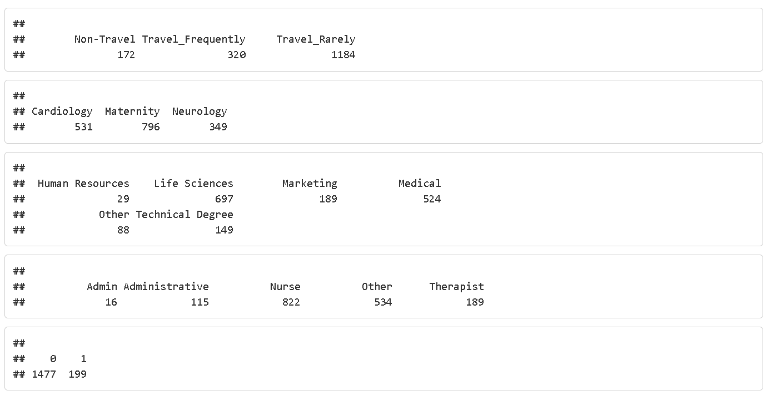
Exploratory Data Analysis: Frequency Tables of Categorical Variables

Slide 8
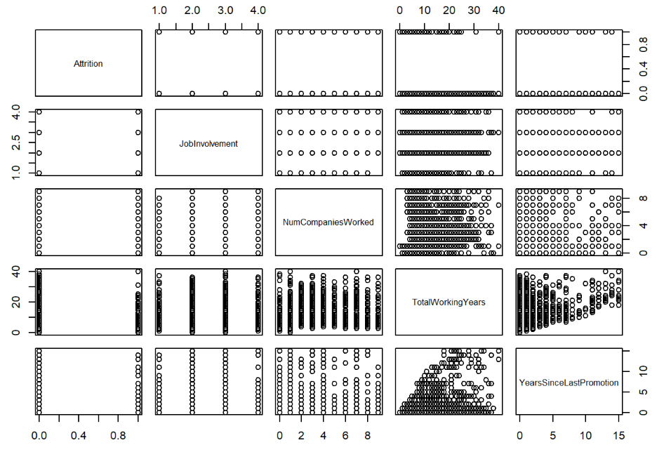
Exploratory Data Analysis: Scatter Plots
My target variable is Attrition. I look at the scatter plot matrix from the perspective of Attrition being in the y-axis. Looking at the plot, there is hardly any highly positive correlation between target variable and predictor variables. It looks like Attrition and JobInvolvement and TotalWorkingYears are slightly negatively correlated.

Slide 9
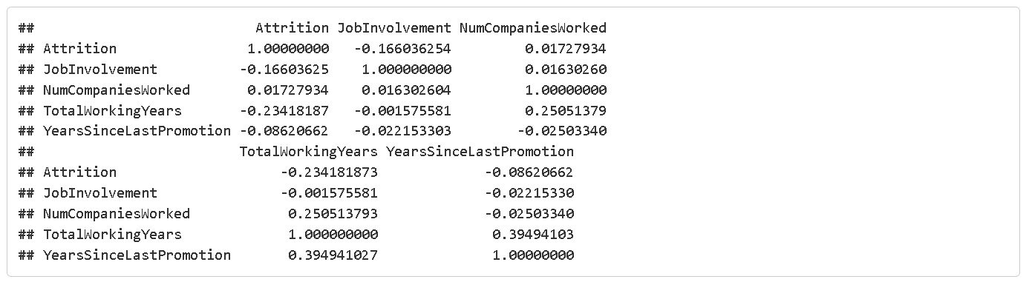
Predictors to be used in the Model
Based of Job Involvement and Total Working Years as predictors for my target variable Attrition. I also provide below correlations matrix between these variables.

Slide 10
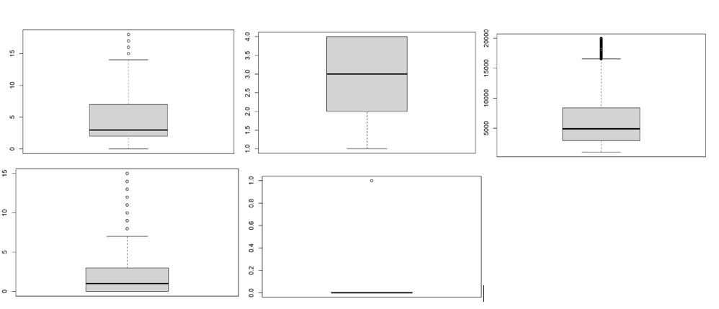
Predictors to be used in the Model
Based YearsInCurrentRole is right skewed. JobSatisfaction, MonthlyIncome, YearsSinceLastPromotion, variables are left, right and right skewed respectively. Attrition is right skewed.

Slide 11
The Prediction Model
Initially created a linear model using the significant variables with the reference from the previous analysis
And following are the features used, Age + BusinessTravel + Department + EnvironmentSatisfaction + JobInvolvement + JobLevel + JobRole + JobSatisfaction + MaritalStatus + MonthlyIncome + OverTime+ TotalWorkingYears + YearsInCurrentRole + YearsWithCurrManager
Major factors influencing the iteration rate turned out to be Business travel, Dist from home, Environmental satisfaction, Job Involvement, Job Satisfaction, Marital Status, Monthly Income, No. of companies worked, work life balance, Years in current role and Years Since Last Promotion.
lm(formula = YearsAtCompany ~ Age + BusinessTravel + Department + EnvironmentSatisfaction + JobInvolvement + JobLevel + JobRole + JobSatisfaction + MaritalStatus + MonthlyIncome + OverTime + TotalWorkingYears + YearsInCurrentRole + YearsWithCurrManager, data = training_data).

Slide 12
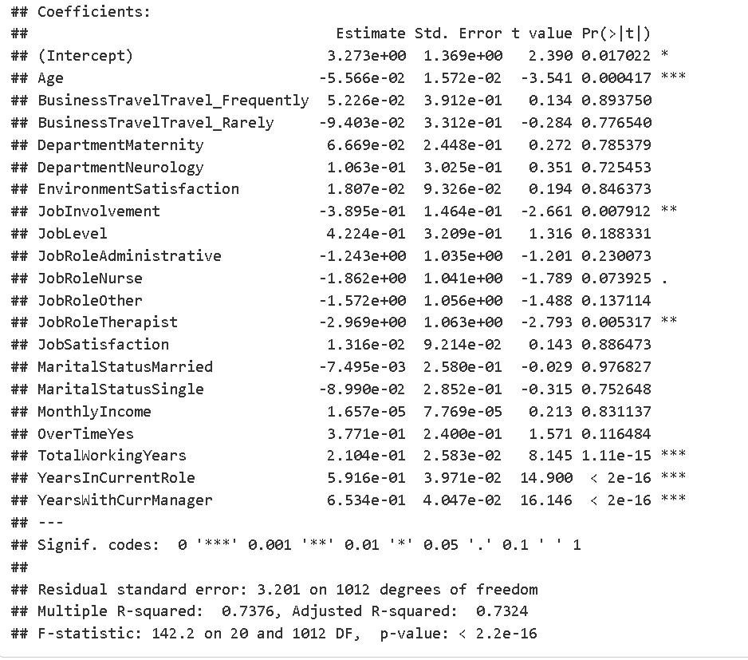
The Regression Summary Report

Slide 13
Comments on the Regression Report
Major factors influencing the iteration rate turned out to be Business travel, Dist from home, Environmental satisfaction, Job Involvement, Job Satisfaction, Marital Status, Monthly Income, No. of companies worked, work life balance, Years in current role and Years Since Last Promotion.
It looks like Attrition and Job Involvement and Tota lWorkingYears are slightly negatively correlated.
The model can now predict if the person will leave the organization or not with an accuracy of 89.9%.
And it was observed that there was no change in the value of R^2 and adjusted R^2 which are now at .734 and .731 respectively.

Slide 14
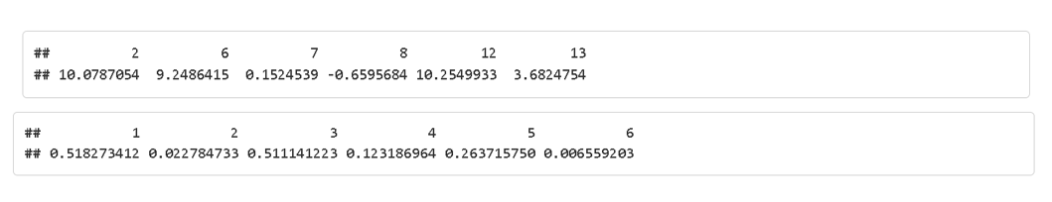
Model Performance
The model is applied on the validation and training sets and performance measures are calculated
There is a big difference in RMSE between training and validation.
The model is good to use for actual predictions.

Slide 15
Conclusion and Final Remarks
In this project, a dataset is selected that showed specific information about employee attrition healthcareMy target variable is Attrition. I look at the scatter plot matrix from the perspective of Attrition being in the y-axis. Looking at the plot, there is hardly any highly positive correlation between target variable and predictor variables. It looks like Attrition and JobInvolvement and TotalWorkingYears are slightly negatively correlated.
Future studies may use a larger dataset, different methods to select the predictors, and useof alternative prediction techniques such as decision trees, Erik Dreyer.
We did not encounter any major difficulty in this project because the data was already cleaned and ready to use.

